Slide 1
Image Transforms
Transforming images to images

Slide 2
Classification of Image Transforms
Point transforms
  modify individual pixels
  modify pixels’ locations
Local transforms
  output derived from neighbourhood
Global transforms
  whole image contributes to each output value

Slide 3
Point Transforms
Manipulating individual pixel values
  Brightness adjustment
  Contrast adjustment
Histogram manipulation
  equalisation
Image magnification

Slide 4
Monadic, Point-by-point Operators
Monadic point-to-point operator

Slide 5
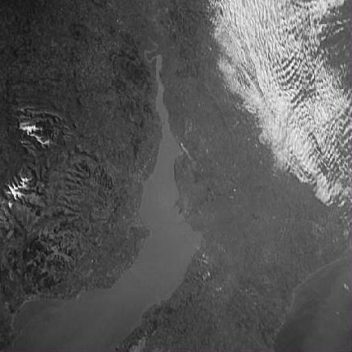
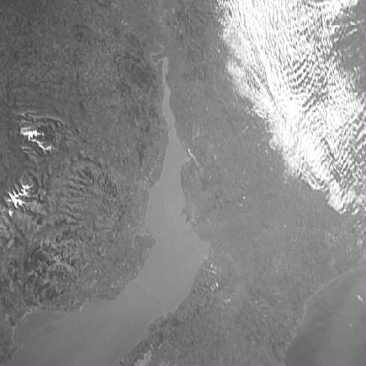
Brightness Adjustment
Add a constant to all values
g’ = g + k
(k = 50)

Slide 6
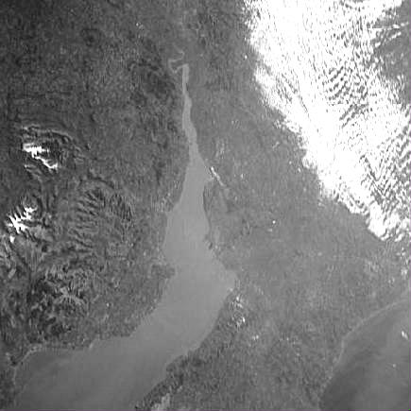
Contrast Adjustment
Scale all values by a constant
g’ = g*k
(k = 1.5)

Slide 7
Contrast Enhancement
Add
Subtract
Multiply
Divide
Maximum
Minimum

Slide 8
A sub-image
(x-1, y-1) (x, y-1) (x+1, y-1)
(x-1, y) (x,y) (x+1,y)
(x-1,y+1) (x, y+1) (x+1, y+1)

Slide 9
Intensity Shift
C(x,y) <=
Where k is a user defined variable
0 a(x,y)+k < 0
a(x,y) +k 0<=a(x,y) +k <=W
W W<a(x,y) +k

Slide 10
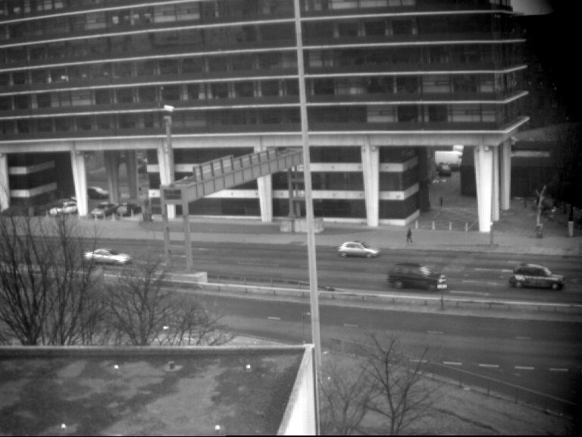
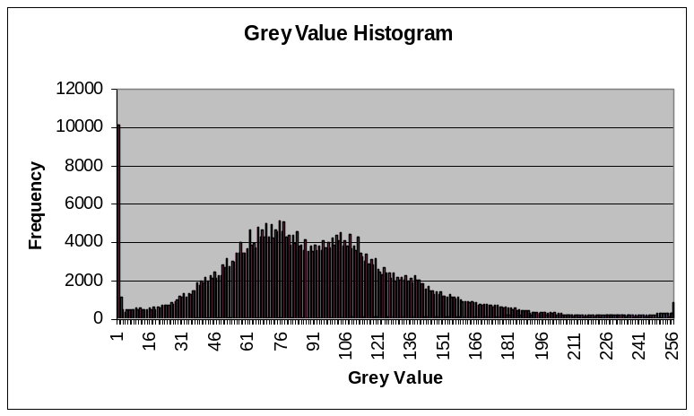
Image Histogram
Measure frequency of occurrence of each grey/colour value

Slide 11
Histogram Manipulation
Modify distribution of grey values to achieve some effect

Slide 12
Histogram Equalization
An important operator for image enhancement is given by the transformation:
C(x,y)<=
W x H (a(x,y))
m x n

Slide 13
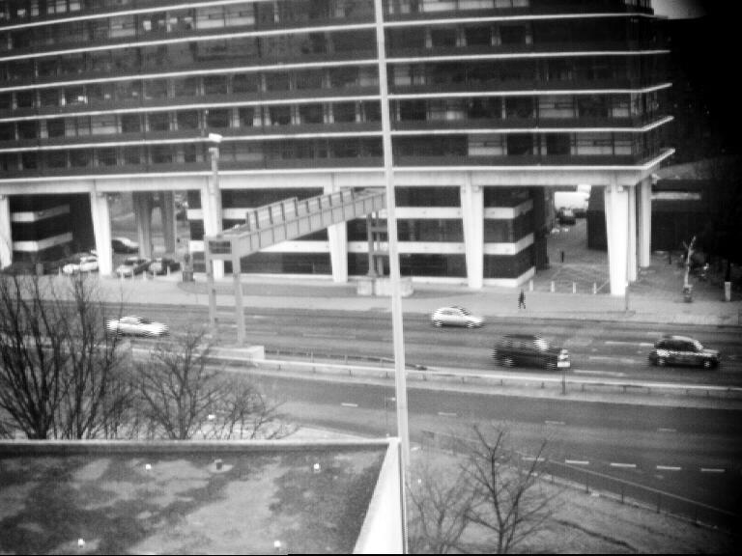
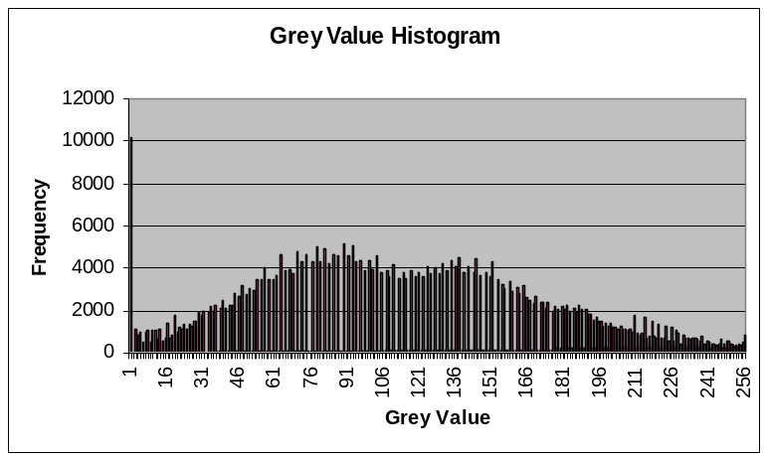
Equalisation/Adaptive Equalisation
Specifically to make histogram uniform

Slide 14
Retrieval based on colour
Retrieval by colour similarity requires that models of colour stimuli are used, such that distances in the colour space correspond to human perceptual distances between colours.
Colour patterns must be represented in such a way that salient chromatic properties are captured.

Slide 15
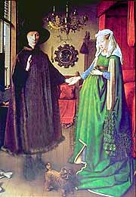
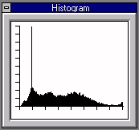

Slide 16
Colour Histogram
Application example - colour histogram retrieval: This method is to retrieve images from the database that have perceptually similar colour to the input image or input description from the user.
The basic idea is to quantize each of the RGB values into m intervals resulting in a total number of m³ colour combinations (or bins)
A colour histogram H(I) is then constructed. This colour histogram is a vector {h1, h2, …, hm³} where element hx represents the number of pixels in image I falling within bin x.

Slide 17
Colour Histogram
The colour histogram becomes the index of this image
To retrieve image from the database, the user supplies either a sample image or a specification for the system to construct a colour histogram H(Q).
A distance metric is used to measure the similarity between H(Q) and H(I). Where I represents each of the images in the database. And example distance metric is shown as follows:
_{x=m}³
D(Q, I ) = Σ |q_{x}-i_{x}|
^{x=1}
Where q_{x} and i_{x} are the numbers of pixels in the image Q and I, respectively, falling within bin x.

Slide 18
Colour Histogram
may fail in recognizing images with perceptually similar colours but no common colours. This may be due to a shift in colour values, noise or change in illumination. – measure the similarity
Not enough for complicated images where spatial position is more important information.
  May consider dividing each image into multiple regions and compare the colour histograms of the same regions in the images.
May combine with other methods such as shape and/or texture based retrieval to improve the accuracy of the retrieval.

Slide 19
Threshold
This is an important function, which converts a grey scale image to a binary format. Unfortunately, it is often difficult, or even impossible to find satisfactory values for the user defined integer threshold value

Slide 20
Threshold
C(x,y) <=
for (int y=0; y<height; y++)
for(int x=0; x<width; x++)
if (input.getxy(x,y) < threshold)
output.setxy(x,y, BLACK);
else
output.setxy(x,y,WHITE);
W a(x,y)>=threshold
0 otherwise

Slide 21
Thresholding
Transform grey/colour image to binary
if f(x, y) > T output = 1
else 0
How to find T?

Slide 22
Threshold Value
Manual
  User defines a threshold
P-Tile
Mode
Other automatic methods

Slide 23
Image Magnification
Reducing
  new value is weighted sum of nearest neighbours
  new value equals nearest neighbour
Enlarging
  new value is weighted sum of nearest neighbours
  add noise to obscure pixelation

Slide 24
Local Transforms
Convolution
Applications
  smoothing
  sharpening
  matching

Slide 25
Local Operators
The concept behind local operators is that the intensities of several pixels are combined together in order to calculate the intensity of just one pixel. Amongst the simplest of the local operators are those which use a set of nine pixels arranged in a 3 x 3 square region. It computes the value for one pixel on the basis of the intensities within a region containing 3 x 3 pixels. Other local operators employ larger windows.

Slide 26
Local Operators

Slide 27
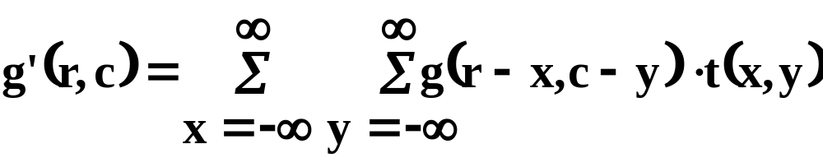
Convolution Definition
Place template on image
Multiply overlapping values in image and template
Sum products and normalise
(Templates usually small)

Slide 28
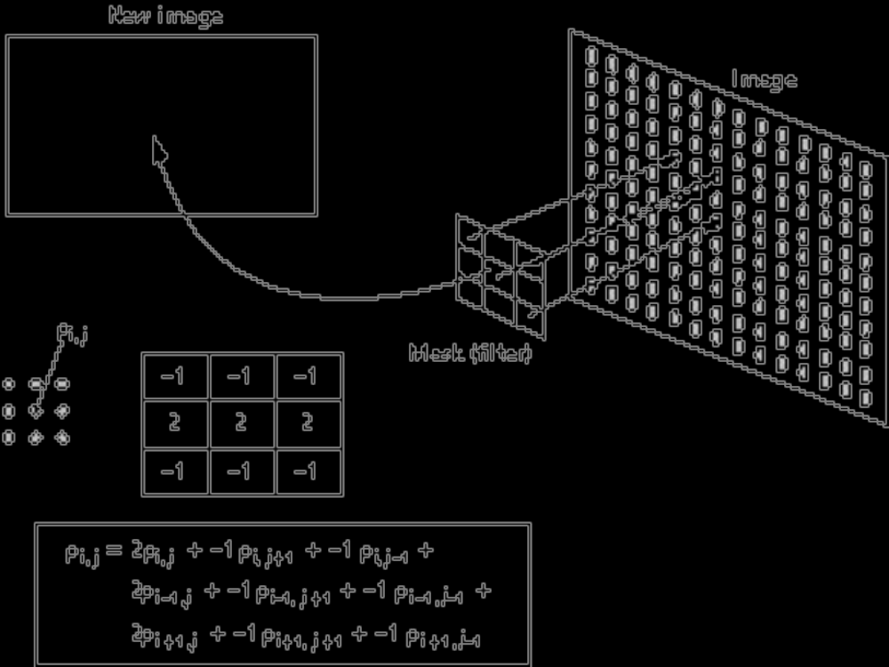

Slide 29
Example
Image
Template
Result
… . . . . . ...
… 3 5 7 4 4 …
… 4 5 8 5 4 …
… 4 6 9 6 4 …
… 4 6 9 5 3 …
… 4 5 8 5 4 …
… . . . . . ...
… . . . . . ...
… . . . . . ...
… . 6 6 6 . …
… . 6 7 6 . …
… . 6 7 6 . …
… . . . . . ...
… . . . . . ...
1 1 1
1 2 1
1 1 1
Divide by template sum

Slide 30
Separable Templates
Convolve with n x n template
  n² multiplications and additions
Convolve with two n x 1 templates
  2n multiplications and additions

Slide 31
Example
Laplacian template
Separated kernels
0 –1 0
-1 4 –1
0 –1 0
-1 2 -1
-1
2
-1

Slide 32
Applications
Usefulness of convolution is the effects generated by changing templates
  Smoothing
    Noise reduction
  Sharpening
    Edge enhancement

Slide 33
Smoothing
Aim is to reduce noise
What is “noise”?
How is it reduced
  Addition
  Adaptively
  Weighted

Slide 34
Noise Definition
Noise is deviation of a value from its expected value
  Random changes
    x → x + n
  Salt and pepper
    x → {max, min}

Slide 35
Noise Reduction
By smoothing
Σ(x + n) = Σ(x) + Σ(n) = Σ(x)
  Since noise is random and zero mean
Smooth locally or temporally
Local smoothing
  Removes detail
  Introduces ringing

Slide 36
Adaptive Smoothing
Compute smoothed value, s
Output = s if |s – x| > T
x otherwise

Slide 37
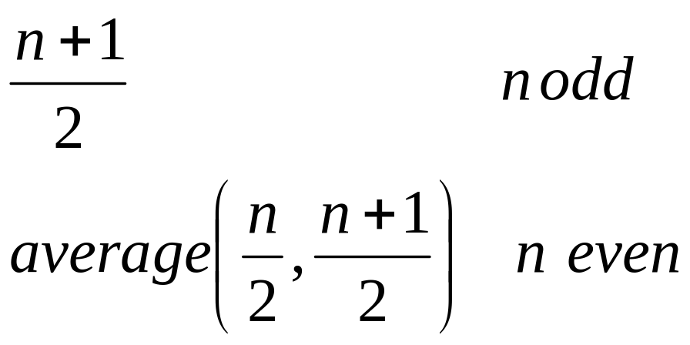
Median Smoothing
Median is one value in an ordered set:
1 2 3 4 5 6 7 → median = 4
2 3 4 5 6 7 → median = 4.5

Slide 38
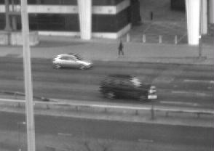


Original
Smoothed
Median Smoothing

Slide 39
Sharpening
What is it?
  Enhancing discontinuities
  Edge detection
Why do it?
  Perceptually important
  Computationally important

Slide 40
Edge Definition
An edge is a significant local change in image intensity.

Slide 41
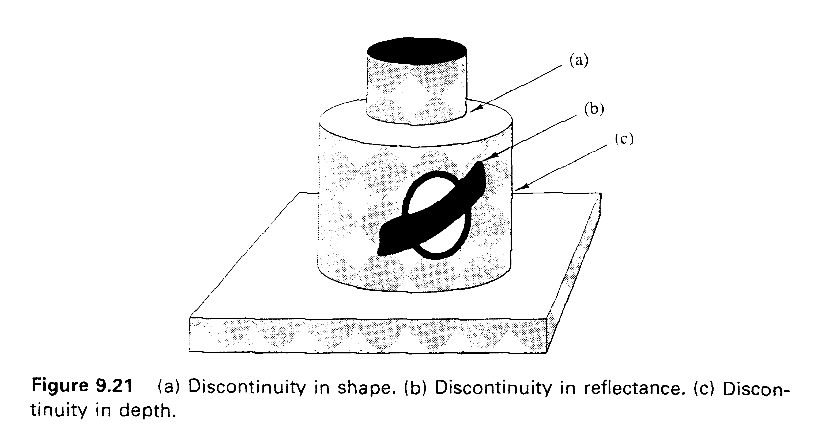
Notes:
Edges are curves in the image plane across which there is a ‘significant’ change in image brightness.
Edge in an image are important because they encode information about the structure of the scene. In figure, we can distinguish several physical events in a scene that lead to intensity edges in an image of the scene. Among these event are discontinuities in the surface normal, in illumination, in depth, and in surface reflectance or in some combination of these.

Slide 42
Algorithms for Edge Detection
Algorithms for detecting edges - edge detectors
  differentiation based
    estimated the derivatives of the image intensity function, the idea being that large image derivatives reflect abrupt intensity changes.
  Model based
    determine whether the intensities in a small area conform to some model for the edges that we have assumed.

Slide 43
First Derivative, Gradient Edge Detection
If an edge is a discontinuity
Can detect it by differencing

Slide 44
Roberts Cross Edge Detector
Simplest edge detector
Inaccurate localisation
-1 | 0
0 | 1
0 | -1
1 | 0

Slide 45
Prewitt/Sobel Edge Detector
-1 | -1 | -1
0 | 0 | 0
1 | 1 | 1
-1 | 0 | 1
-1 | 0 | 1
-1 | 0 | 1

Slide 46
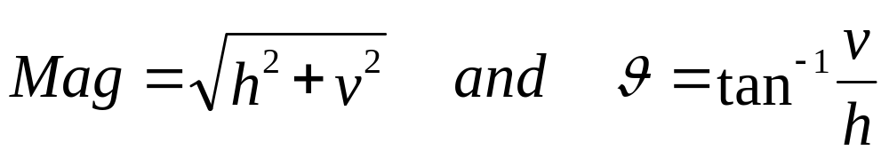
Edge Detection
Combine horizontal and vertical edge estimates

Slide 47
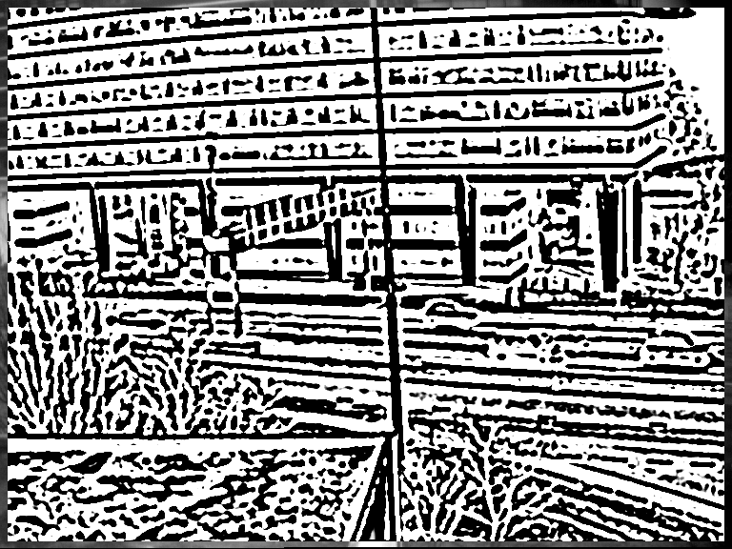
Example Results

Slide 48
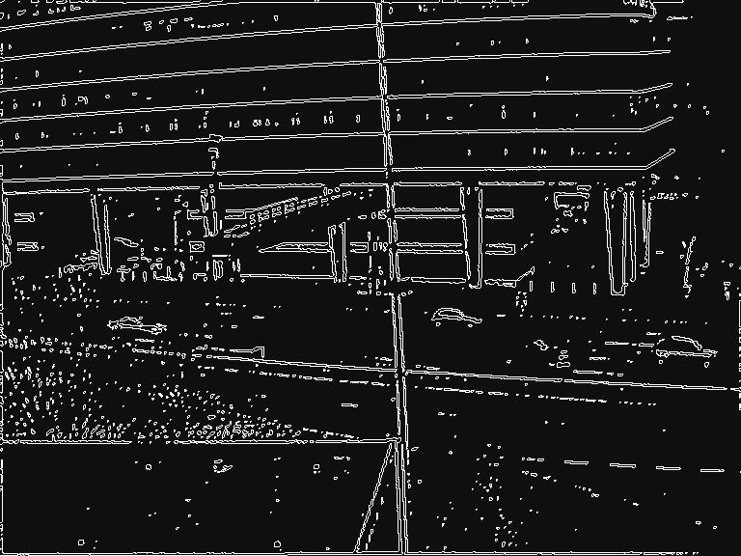
Example Results

Slide 49
Global Transforms
Computing a new value for a pixel using the whole image as input
Cosine and Sine transforms
Fourier transform
  Frequency domain processing
Hough transform
Karhunen-Loeve transform
Wavelet transform
Notes:
Terms to be aware about

Slide 50
Geometric Transformations
Definitions
  Affine and non-affine transforms
Applications
  Manipulating image shapes

Slide 51
Affine Transforms
Scale, Shear, Rotate, Translate
Length and areas preserved.
[
]
[
]
[
]
x’
y’
1
=
a b c
d e f
g h i
x
y
1
Change values of transform matrix elements according to desired effect.
a, e → scaling
b, d → shearing
a, b, d, e → rotation
c, f → translation

Slide 52
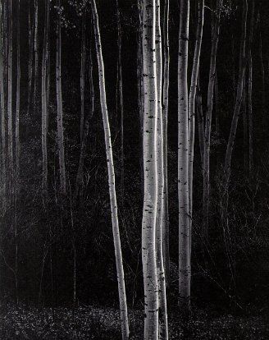
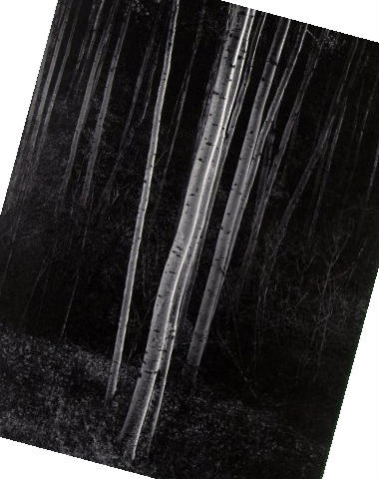
Affine Transform Examples

Slide 53
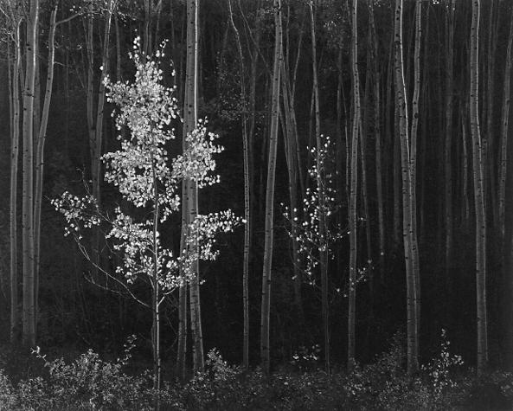
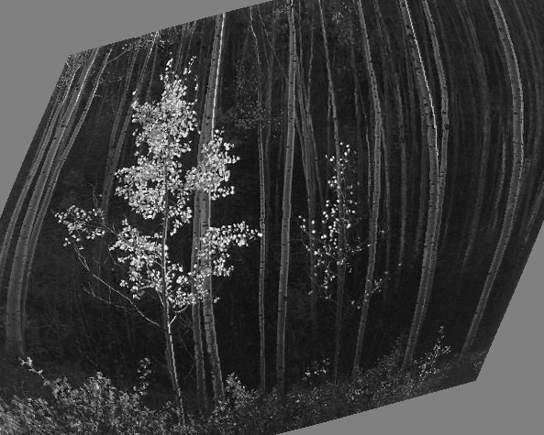
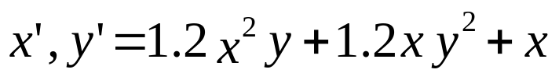
Warping Example
Ansell Adams’ Aspens

Slide 54
Image Resampling
Moving source to destination pixels
x’ and y’ could be non-integer
Round result
  can create holes in image
Manipulate in reverse
  where did warped pixel come from
  source is non-integer
    interpolate nearest neighbours

Slide 55
Summary
Point transforms
  scaling, histogram manipulation,thresholding
Local transforms
  edge detection, smoothing
Global transforms
  Fourier, Hough, Principal Component, Wavelet
Geometrical transforms

